Slide 1


Jose M Romero
12/16/2022

Slide 2
Outline
Executive Summary
Introduction
Methodology
Results
Conclusion
Appendix

Slide 3
Executive Summary
Summary of methodologies
Title: Determining the price of each launch and if SpaceX will reuse the first stage
Purpose: The purpose of this project was to apply methodologies to determine the price of each launch. Additionally, to train a machine learning model and use public information to predict if SpaceX will reuse the first stage.
Methodologies: To accomplish this task, we used SpaceX launch data that is gathered from an API, specifically SpaceX REST API. This API gave us data about launches, rocket used, payload delivered, launch specifications, landing specifications, and landing outcomes. We then used this data to train and test a machine learning model using a variety of algorithms, including decision tree. Lastly, we evaluated the performance of the model using the score method to find the method that performs best.
Key Findings: Our machine learning model was able to accurately predict if the first stage will land with an AUC of 0.83. We also identified some key features that were most predictive of the first stage landing including landing site and payload weight.
Summary of all results
Recommendations: Based on our analysis, we recommend that launches with a low payload mass show better results than launches with a larger payload mass.
Limitations: Our analysis was limited to data available and may not fully capture all factors that could affect rocket price launch and if Spacex will reuse the first stage.

Slide 4
Introduction
Project background and context
The commercial space age is here, companies are making space travel affordable for everyone. Virgin Galactic is providing suborbital spaceflights. Rocket Lab is a small satellite provider. Blue Origin manufactures sub-orbital and orbital reusable rockets. Perhaps the most successful is SpaceX. SpaceX’s accomplishments include Sending spacecraft to the International Space Station. Starlink, a satellite internet constellation providing satellite Internet access. Sending manned missions to Space.
One reason SpaceX can do this is the rocket launches are relatively inexpensive. SpaceX advertises Falcon 9 rocket launches on its website with a cost of 62 million dollars; other providers cost upwards of 165 million dollars each, much of the savings is because SpaceX can reuse the first stage. Therefore, if we can determine if the first stage will land, we can determine the cost of a launch.
Problems you want to find answers
How does the weight of the payload mass affect the performance of the first stage landing?
Does the location of the launch site affect the success of the landing?
How many number of flights can we reuse the first stage before repeated use wears down its components and decreases reliability?
How does launching rockets into different orbits affect the performance of the landing?

Slide 5

Section 1

Slide 6
Methodology
Executive Summary
Data collection methodology:
SpaceX API
Web scraping Falcon 9 and Falcon Heavy Launches from Wikipedia
Perform data wrangling
Dealing with missing values
Calculate the number and occurrence of mission outcome per orbit type
Perform exploratory data analysis (EDA) using visualization and SQL
Perform interactive visual analytics using Folium and Plotly Dash
Perform predictive analysis using classification models
How to build, tune, evaluate classification models

Slide 7
Data Collection
Data sets were collected by using SpaceX REST API and BeautifulSoup to Web scrape some HTML tables from Wikipedia.
Using both methodologies we were able to gather detailed information about the launches for a more detailed analysis.
Data Columns are obtained by using SpaceX REST API:
FlightNumber, Date, BoosterVersion, PayloadMass, Orbit, LaunchSite, Outcome, Flights, GridFins, Reused, Legs, LandingPad, Block, ReusedCount, Serial, Longitude, Latitude
Data Columns are obtained by using Wikipedia Web Scraping:
Flight No., Launch site, Payload, PayloadMass, Orbit, Customer, Launch outcome, Version Booster, Booster landing, Date, Time

Slide 8

Data Collection – SpaceX API
Request rocket launch data using SpaceX REST API
Decode the response content by applying .json() and turning it into a dataframe applying .json_normalize()
Request data about the launches from SpaceX API by applying functions
Convert the data we have wrangled by turning it into a dictionary
Convert the dictionary from the previous step into a dataframe
Filter the dataframe to only include Falcon 9 launches
Calculate the mean for PayLoadMass. Then use replace function to replace the missing values.
Export the data to CSV
GitHub URL: Data Collection API

Slide 9
Data Collection - Scraping
Extract
Extract Falcon 9 launch records HTML table from Wikipedia
Create
Create a BeautifulSoup object to pull data out of HTML tables
Extract
Extract all column names from the HTML table header
Collect
Collect the data by parsing HTML tables
Create
Create a dictionary from the data we have gathered
Create
Create a dataframe from the dictionary
Export
Export the data to CSV file
GitHub URL: Data Collection with Web Scraping

Slide 10
Data Wrangling
Perform
Perform Exploratory Data Analysis and determine training labels
Calculate
Calculate the number of launches on each site
Calculate
Calculate the number and occurrences of each orbit
Calculate
Calculate the number and occurrences of mission outcome per orbit type
Create
Create a landing outcome label from Outcome column
Export
Export the data to CSV file
In data set there are several instances where the rocket did not successfully land. For example, True Ocean means the mission outcome was a successful landing in the ocean. While False Ocean means the mission outcome was a failure and did not land in the given location.
True RTLS means the mission outcome was successful in landing in the ground pad.
False RTLS means the mission outcome was unsuccessful in landing in the ground pad.
True ASDS means the mission outcome was a success in landing on a drone ship.
False ASDS means the mission outcome was unsuccessful in landing on a drone ship.
We converted these outcome into Training Labels with 1 meaning the booster landed successfully and 0 means it did not land successfully
GitHub URL: Data Wrangling

Slide 11
EDA with Data Visualization
Charts Plotted:
Flight Number vs. Payload Mass, Flight Number vs. Launch Site, Payload Mass vs. Launch Site, Orbit Type vs. Success Rate, Flight Number vs. Orbit Type, Payload Mass vs Orbit Type and Success Rate Yearly Trend
Using scatter plots shows the relationship between variables. If a relationship does exist, we may use them in a machine learning model.
In addition, bar charts show the comparison between categories. The purpose is to show the relationship between specific categories being compared.
Lastly using line charts shows trends over time within the data over time.
GitHub URL: EDA with Data Visualization

Slide 12

EDA with SQL
SQL queries performed:
Displaying the names of the unique launch sites in the space mission
Displaying 5 records where launch sites begin with the string ‘CCA'
Displaying the total payload mass carried by boosters launched by NASA (CRS)
Displaying average payload mass carried by booster version F9 v1.1
Listing the date when the first successful landing outcome in ground pad was achieved
Listing the names of the boosters which have success in drone ship and have payload mass greater than 4000 but less than 6000
Listing the total number of successful and failure mission outcomes
Listing the names of the booster versions which have carried the maximum payload mass
Listing the failed landing outcomes in drone ship, their booster versions and launch site names for the months in year 2015
Ranking the count of landing outcomes (such as Failure (drone ship) or Success (ground pad)) between the date
2010-06-04 and 2017-03-20 in descending order
GitHub URL: EDA with SQL

Slide 13
Build an Interactive Map with Folium
Markers of Launch Sites:
Added Marker with Circle, Popup Label and Text Label of NASA Johnson Space Center using its latitude and longitude coordinates as a start location.
Added Markers with Circle, Popup Label and Text Label of all Launch Sites using their latitude and longitude coordinates to show their geographical locations and proximity to Equator and coasts.
Colored Markers of the launch outcomes for each Launch Site:
Added colored markers of success using green and for failed launches red
Used marker clusters to identify which launch sites have high success rates.
Distances between a Launch site to its proximities:
Added colored lines to show the distance between launch sites and its proximities i.e., railway, highway, coastline, and closest city.
GitHub URL: Interactive Visual Analytics with Folium

Slide 14
Build a Dashboard with Plotly Dash
Launch Sites Dropdown List:
Added a launch site drop down input component.
Pie Chart
Added a piechart to show the total successful launches for all sites.
Added Success vs. Failed counts for the site, if a specific launch site was selected.
Range Slider to Select Payload
Added range slider to be able to easily select different payload range and see it we can identify some visual patterns.
Scatter Chart of Payload Mass vs. Success Rate For The Different Booster Versions:
Added a scatter plot to visually observe how payload may be correlated with mission outcomes for selected sites.
GitHub URL: SpaceX Dash App

Slide 15
Predictive Analysis (Classification)
Create a Numpy array from the column “Class” in data, by applying the method “to_numpy”
Standardize the data using the method StandardScaler, then we use the methods “fit” and “transform”
Use the function train_test_split to split the data X and Y into training and test data
Create a GridSearchCV object with cv = 10 for LogReg, SVM, Decision Tree, and KNN to find the best parameters from the dictionary parameters
Apply GridSearchCV on LogReg, SVM, Decision Tree, and KNN models
Calculate the accuracy on the test data using the method “.score()”
Analyze the confusion matrix for all models
Find the method that performs best by analyzing the accuracy of each method
GitHub URL: Machine Learning Prediction

Slide 16

Results
Exploratory data analysis results
Interactive analytics demo in screenshots
Predictive analysis results

Slide 17

Section 2

Slide 18
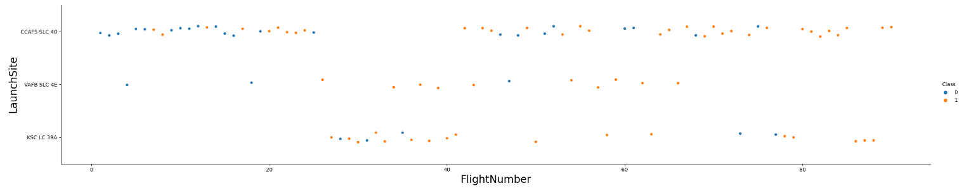
Flight Number vs. Launch Site
We see that different launch sites have different success rates
CCAFS LC-40, has a success rate of 60%
KSC LC-39A and VAFB SLC 4E has a success rate of 77%

Slide 19
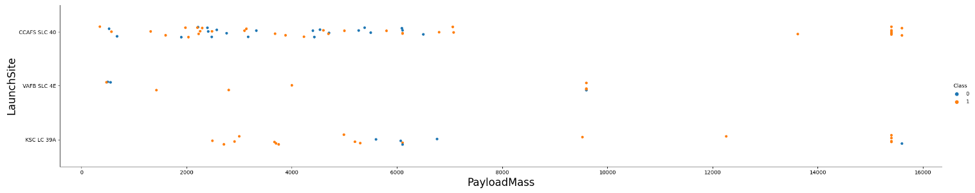
Payload vs. Launch Site
For VAFB-SLC launchsite there are no rockets launched for heavypayload mass greater than 10,000 KG
KSC LC 39A has a 100% success rate for payload mass under 5500 KG
For CCAFS SLC 40, VAFB SLC 4E, KSC LC 39A payloads with mass over 8000 KG are mostly successful

Slide 20
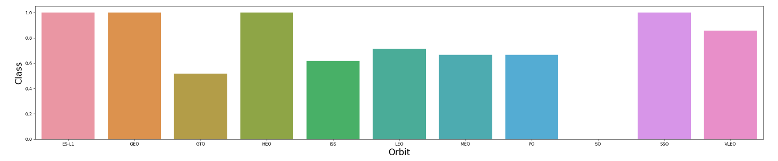
Success Rate vs. Orbit Type
Orbits with success rate between 50% and 85%:
GTO, ISS, LEO, MEO, PO
Orbits with 0% success rate:
SO
Orbits with 100% success rate:
ES-L1, GEO, HEO, SSO

Slide 21
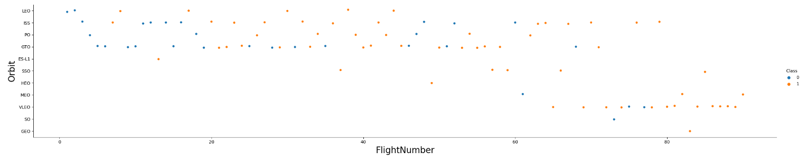
Flight Number vs. Orbit Type
In the LEO orbit the success appears related to the number of flights
On the other hand, there seems to be no relationship between flight number when in GTO orbit

Slide 22
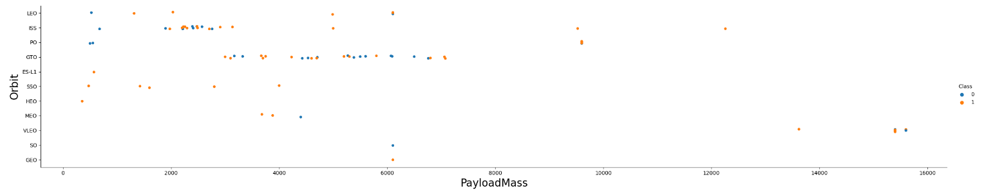
Payload vs. Orbit Type
With heavy payloads the successful landing or positive landing rate are more Polar, LEO and ISS
However, for GTO we cannot distinguish this well as both positive landing rate and negative landing(unsuccessful mission) are both there

Slide 23
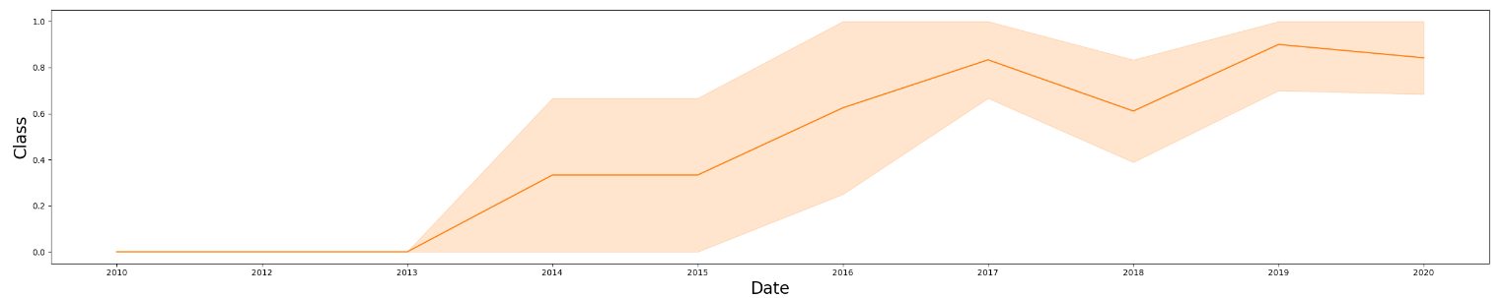
Launch Success Yearly Trend
The success rate since 2013 kept increasing till 2020

Slide 24

EDA with SQL

Slide 25
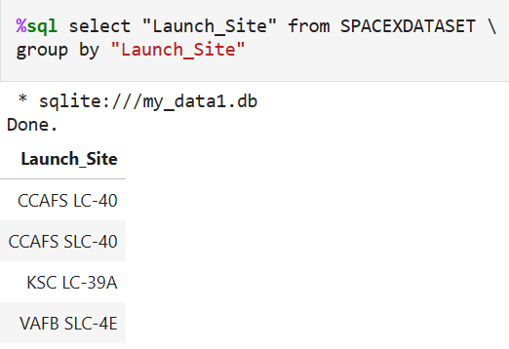
All Launch Site Names
Display the names of the unique launch sites in the space mission

Slide 26
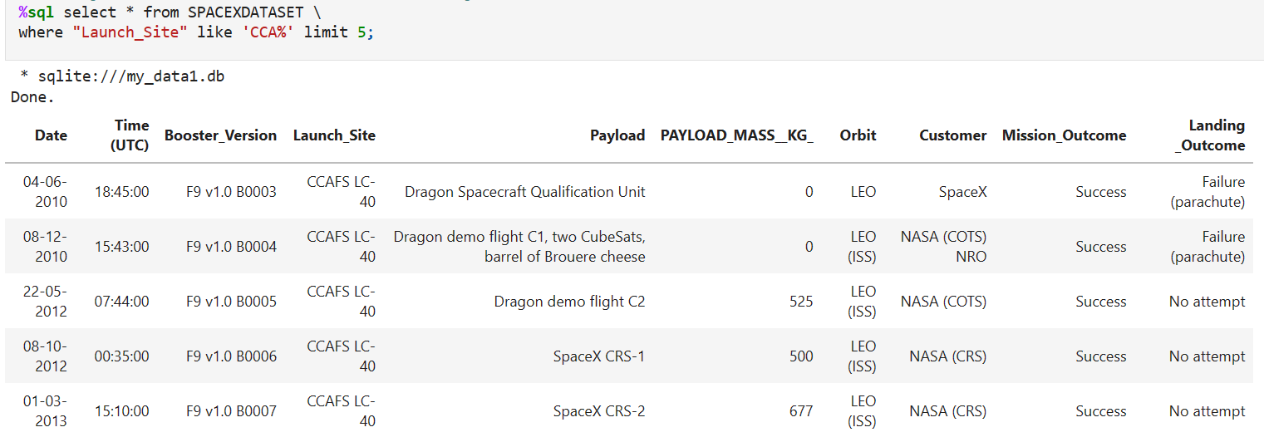
Launch Site Names Begin with 'CCA'
Display 5 records where launch sites begin with the string ‘CCA’

Slide 27
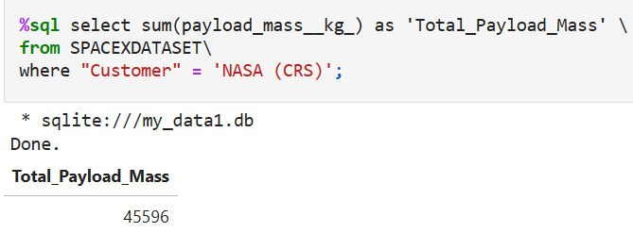
Total Payload Mass
Display the total payload mass carried by boosters launched by NASA(CRS)

Slide 28
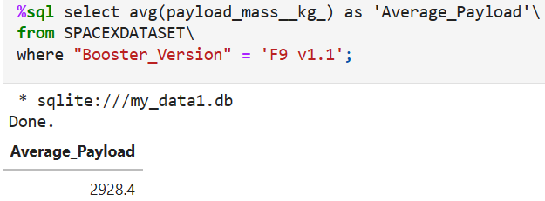
Average Payload Mass by F9 v1.1
Display average payload mass carried by booster version F9 v1.1

Slide 29
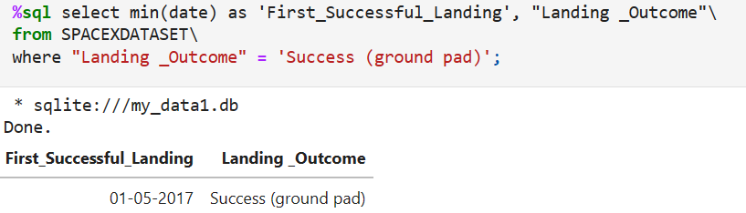
First Successful Ground Landing Date
Listing the date when the first successful landing outcome in ground pad was achieved

Slide 30
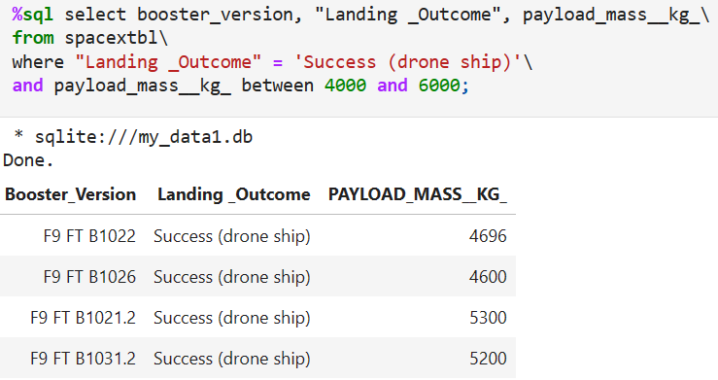
Successful Drone Ship Landing with Payload between 4000 and 6000
List the names of boosters which have successfully landed on drone ship and had payload mass greater than 4000 but less than 6000

Slide 31
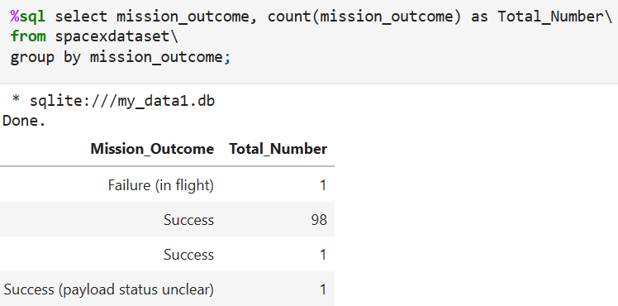
Total Number of Successful and Failure Mission Outcomes
Calculate the total number of successful and failure mission outcomes

Slide 32
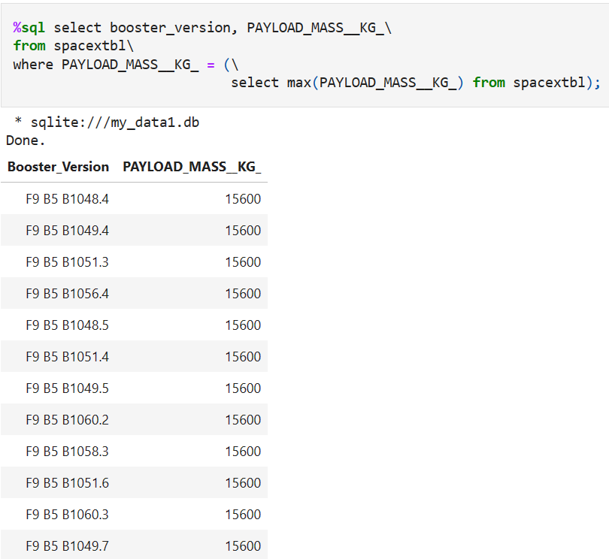
Boosters Carried Maximum Payload
List the names of the booster which have carried the maximum payload mass

Slide 33
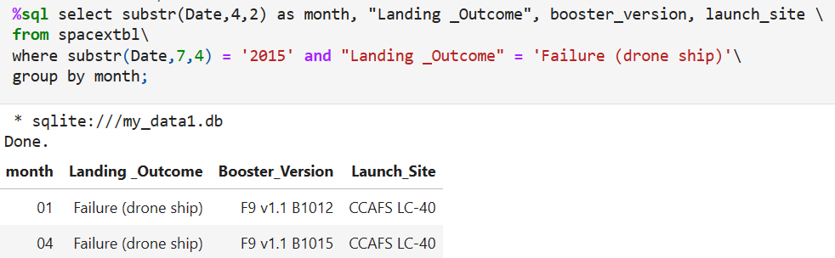
2015 Launch Records
List the failed landing outcomes in drone ship, their booster versions, and launch site names for in year 2015

Slide 34
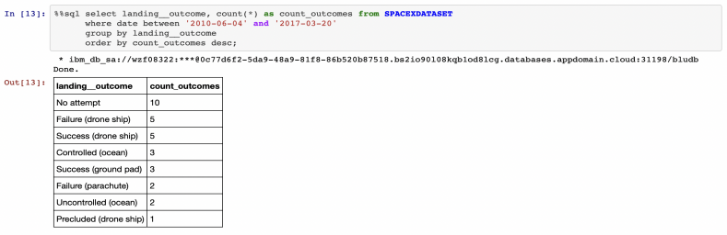
Rank Landing Outcomes Between 2010-06-04 and 2017-03-20
Rank the count of landing outcomes (such as Failure (drone ship) or Success (ground pad)) between the date 2010-06-04 and 2017-03-20, in descending order

Slide 35

Section 3

Slide 36
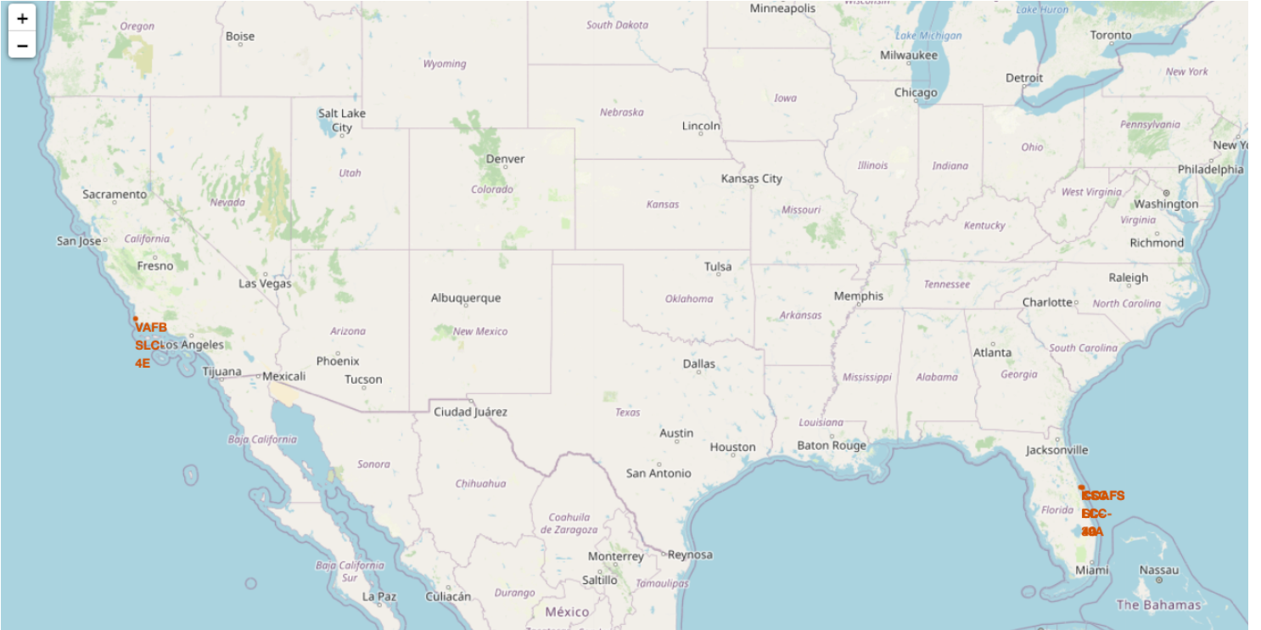
Launch Sites In The United States
Rockets are launched from the equator for a few reasons. One reason is that the Earth's rotation is fastest at the equator, which means that a rocket launched from the equator will receive a boost from the Earth's rotational velocity. This can save on fuel and increase the payload that a rocket can carry.
Another reason is that the Earth's magnetic field is tilted at about 11 degrees relative to its rotational axis. This means that at higher latitudes, the Earth's magnetic field can interfere with the rocket's guidance systems and cause errors. Launching from the equator minimizes this effect.
Finally, launching from the equator also allows rockets to take advantage of the Earth's rotational momentum to reach a desired orbit more efficiently. This can be particularly important for geostationary orbits, which require a specific inclination relative to the equator.
Launch sites are often located near the ocean for a few reasons. One reason is that rockets generate a lot of noise and can produce sonic booms when they take off. Launching over the ocean can help to reduce the impact of this noise on nearby communities.
Another reason is that rockets can produce debris during launch and launching over the ocean can help to minimize the risk of this debris falling on populated areas. The ocean is also a convenient location for recovery operations if a rocket or its components need to be retrieved after launch.
Finally, the ocean is also a convenient location for tracking and communication with the rocket during launch. Many launch sites are located near coastal areas where there are already established infrastructure and facilities for tracking and communication.

Slide 37
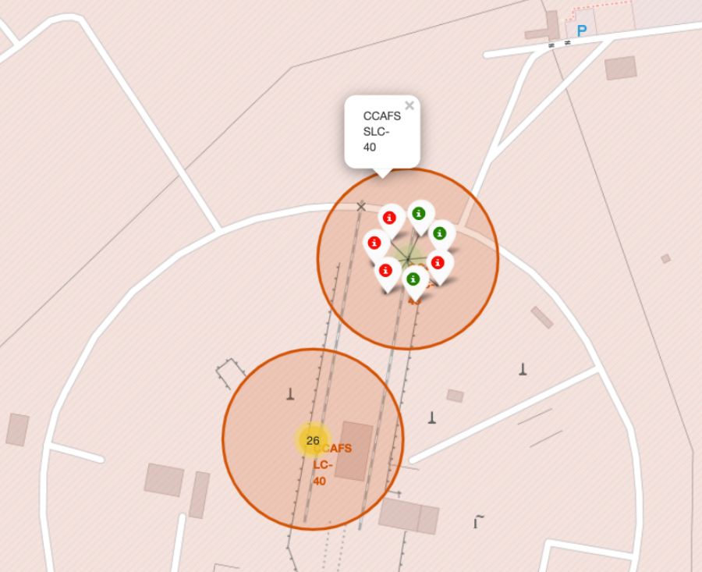
Color Labeled Launch Records On The Map
From the color-labeled markers we should be able to easily identify which launch sites have relatively high success rates
Green Marker = Successful Launch
Red Marker = Failed Launch

Slide 38
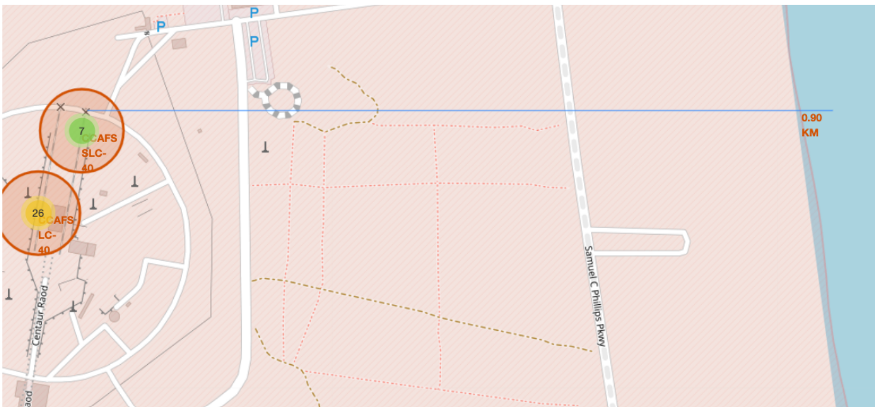
Distance From The Launch Site
From the visual analysis of the launch site CCAFS SLC – 40 we observe that it is 0.90 KM from the coastline

Slide 39

Section 4

Slide 40

Launch Success Count For All Sites
The piechart shows that from all the sites, KSC LC-39A has the most successful launches

Slide 41
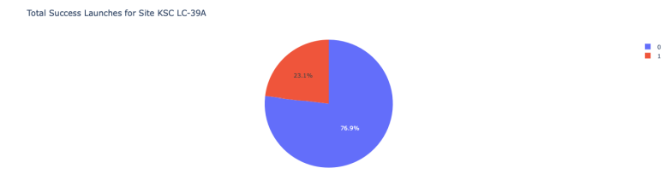
Launch Site With Highest Launch Success Ratio
KSC LC-39A has the highest launch success rate (76.9%) with 10 successful and only 3 failed launches

Slide 42
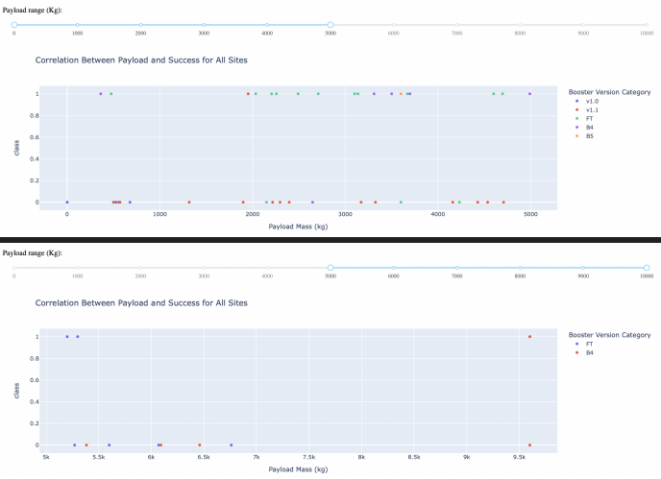
Payload Mass vs Launch Outcome For All Sites
The charts show that payloads between 2000 and 5500 KG have the highest success rate

Slide 43

Section 5

Slide 44
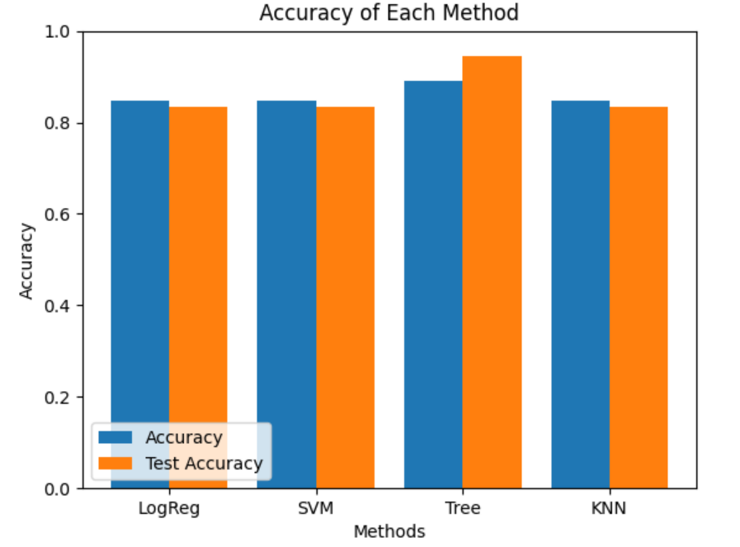
Classification Accuracy
Based on the bar chart the tree model has the highest classification accuracy

Slide 45
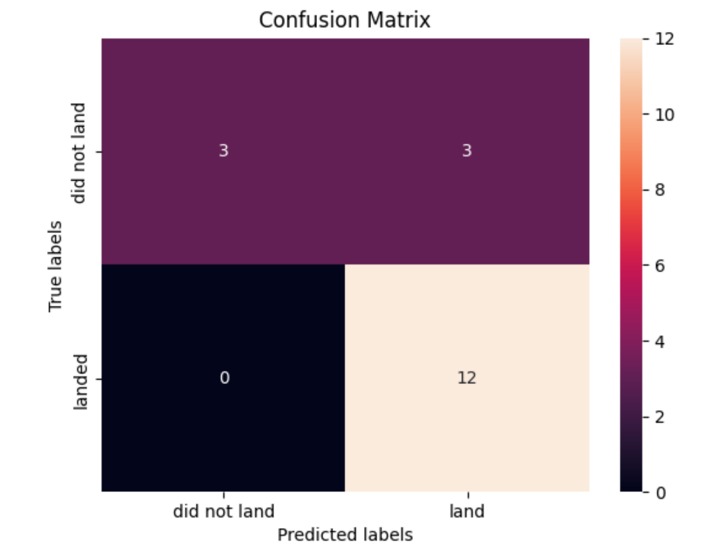
Confusion Matrix
The model for the decision tree classifier shows its accuracy by the number of true positive and true negative compared to the false ones

Slide 46

Conclusions
Based on our analysis we can determine that the decision tree model is the best algorithm
Launches with a lower payload mass prove to be better results than most launches with a greater payload mass
Launch sites are in proximity to the equator line and all sites are in close proximity to the coastline
The success rate of launches increased during 2013-2020
KSC LC-39A has the highest success rate of the launches from all the sites
Decision tree classifier can be used to predict successful landings and increase profits

Slide 47

Appendix
Limitations: Our analysis was limited to data available and may not fully capture all factors that could affect rocket price launch and if SpaceX will reuse the first stage
Folium did not show maps on GitHub
Screenshots were shared
For a more detailed overview of the complete process of this project please visit my GitHub at your most convenient leisure
JBravo805/Applied-Data-Science-Capstone (github.com)

Slide 48


